Slide 1
ANOVA
Dr. Frank Wood
TexPoint fonts used in EMF.
Read the TexPoint manual before you delete this box.: AAAAAAAAAA

Slide 2
ANOVA
ANOVA is nothing new but is instead a way of organizing the parts of linear regression so as to make easy inference recipes.
Will return to ANOVA when discussing multiple regression and other types of linear statistical models.

Slide 3

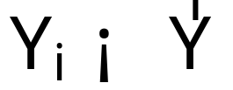
Partitioning Total Sum of Squares
“The ANOVA approach is based on the partitioning of sums of squares and degrees of freedom associated with the response variable Y”
We start with the observed deviations of Y_{i} around the observed mean

Slide 4
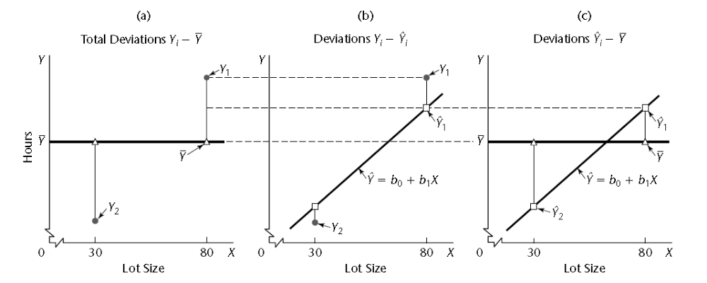
Partitioning of Total Deviations
SSTO
SSE
SSR

Slide 5
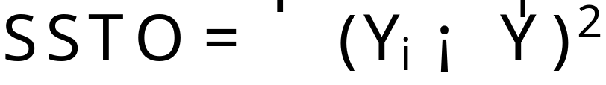
Measure of Total Variation
The measure of total variation is denoted by
SSTO stands for total sum of squares
If all Y_{i}’s are the same, SSTO = 0
The greater the variation of the Y_{i}’s the greater SSTO

Slide 6
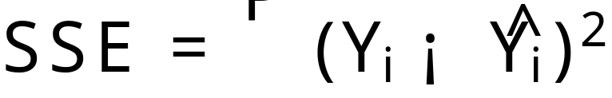
Variation after predictor effect
The measure of variation of the Y_{i}’s that is still present when the predictor variable X is taken into account is the sum of the squared deviations
SSE denotes error sum of squares

Slide 7
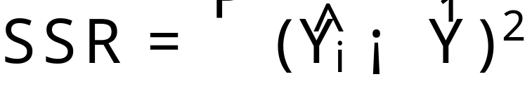
Regression Sum of Squares
The difference between SSTO and SSE is SSR
SSR stands for regression sum of squares

Slide 8
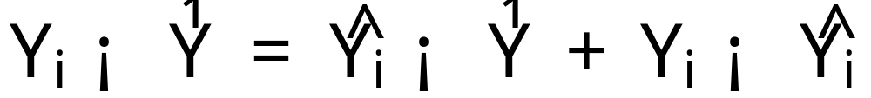
Partitioning of Sum of Squares
Total
deviation
Deviation
of fitted
regression
value
around mean
Deviation
around
fitted
regression
line

Slide 9
Remarkable Property
The sums of the same deviations squared has the same property!
or SSTO = SSR + SSE
Proof:

Slide 10
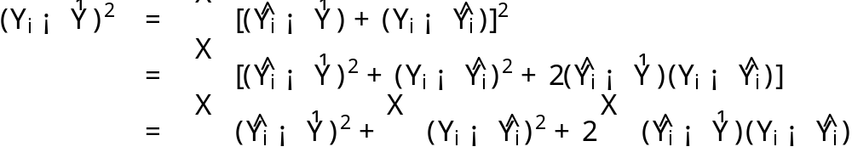
Remarkable Property
Proof:
but
By properties previously demonstrated

Slide 11
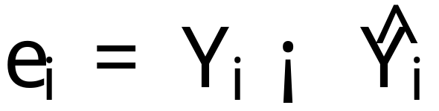
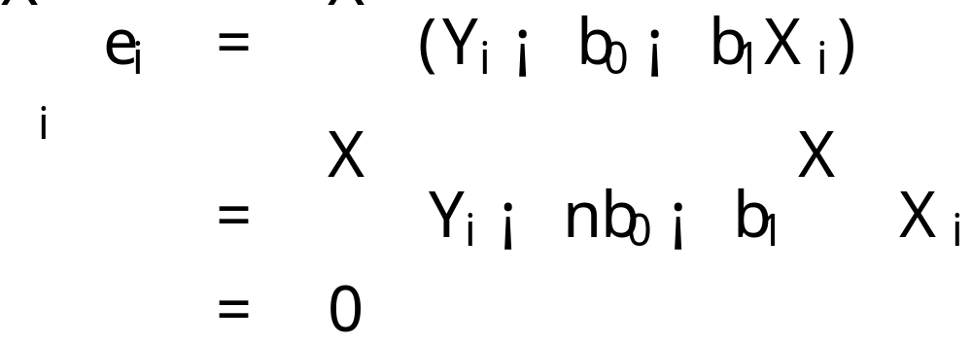
Remember: Lecture 3
The i^{th} residual is defined to be
The sum of the residuals is zero:
By first normal equation.

Slide 12
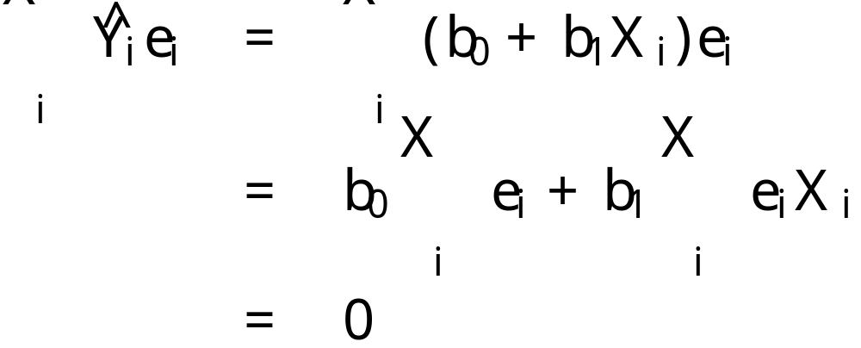
Remember: Lecture 3
The sum of the weighted residuals is zero when the residual in the i^{th} trial is weighted by the fitted value of the response variable for the i^{th} trial
By previous properties.

Slide 13
Breakdown of Degrees of Freedom
SSTO
  1 linear constraint due to the calculation and inclusion of the mean
    n-1 degrees of freedom
SSE
  2 linear constraints arising from the estimation of ¯₁ and ¯₀
    n-2 degrees of freedom
SSR
  Two degrees of freedom in the regression parameters, one is lost due to linear constraint
    1 degree of freedom

Slide 14
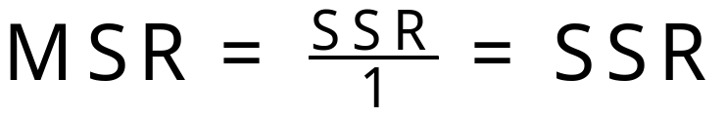
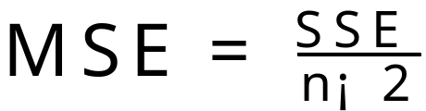
Mean Squares
A sum of squares divided by its associated degrees of freedom is called a mean square
  The regression mean square is
  The error mean square is

Slide 15


ANOVA table for simple lin. regression
Source of Variation | SS | df | MS | E{MS}
Regression |  | 1 | MSR = SSR/1
Error |  | n-2 | MSE = SSE/(n-2)
Total |  | n-1

Slide 16
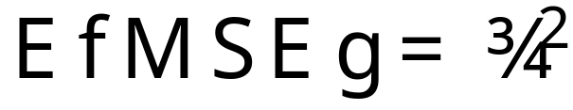
We know from earlier lectures that
  SSE/¾² ~ Â²(n-2)
That means that E{SSE/¾²} = n-2
And thus that E{SSE/(n-2)} = E{MSE} = ¾²

Slide 17
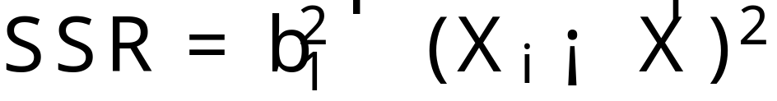
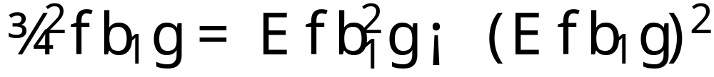
To begin, we take an alternative but equivalent form for SSR
And note that, by definition of variance we can write

Slide 18
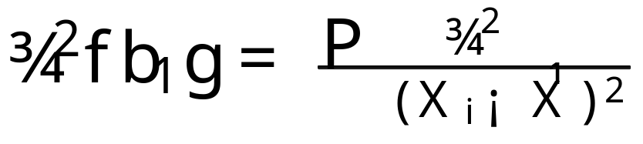
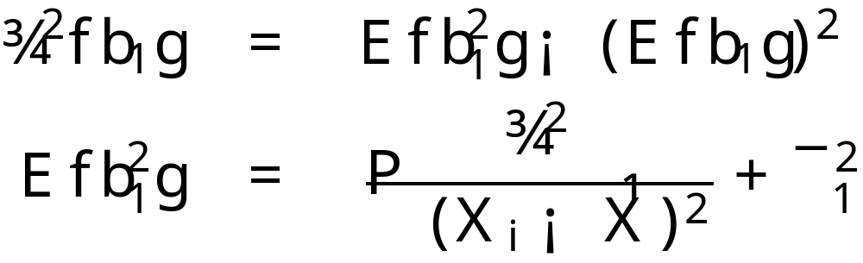
But we know that b₁ is an unbiased estimator of ¯₁ so E{b₁} = ¯₁
We also know (from previous lectures) that
So we can rearrange terms and plug in

Slide 19
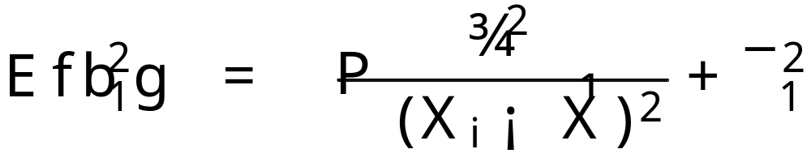
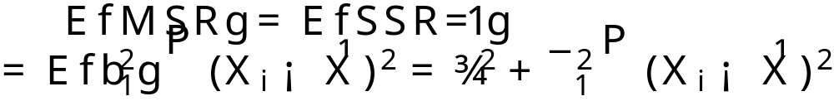
From the previous slide
Which brings us to this result

Slide 20
Comments and Intuition
The mean of the sampling distribution of MSE is ¾² regardless of whether X and Y are linearly related (i.e. whether ¯₁ = 0)
The mean of the sampling distribution of MSR is also ¾² when ¯₁ = 0.
  When ¯₁ = 0 the sampling distributions of MSR and MSE tend to be the same

Slide 21
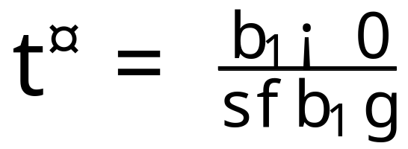
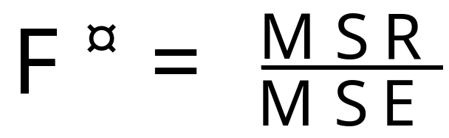
F Test of ¯₁ = 0 vs. ¯₁ ≠ 0
ANOVA provides a battery of useful tests. For example, ANOVA provides an easy test for
  Two-sided test
    H₀ : ¯₁ = 0
    H_{a} : ¯₁ ≠ 0
    Test statistic
Test statistic from before
ANOVA test statistic

Slide 22
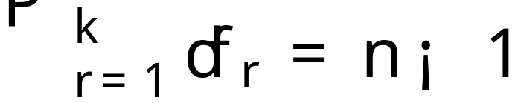
Sampling distribution of F*
The sampling distribution of F* when H₀(¯₁ = 0) holds can be derived starting from Cochran’s theorem
Cochran’s theorem
  If all n observations Y_{i} come from the same normal distribution with mean ¹ and variance ¾², and SSTO is decomposed into k sums of squares SS_{r}, each with degrees of freedom df_{r}, then the SS_{r}/¾² terms are independent Â² variables with df_{r} degrees of freedom if

Slide 23
The F Test
We have decomposed SSTO into two sums of squares SSR and SSE and their degrees of freedom are additive, hence, by Cochran’s theorem:
  If ¯₁ = 0 so that all Y_{i} have the same mean ¹ = ¯₀ and the same variance ¾², SSE/¾² and SSR/¾² are independent Â² variables

Slide 24
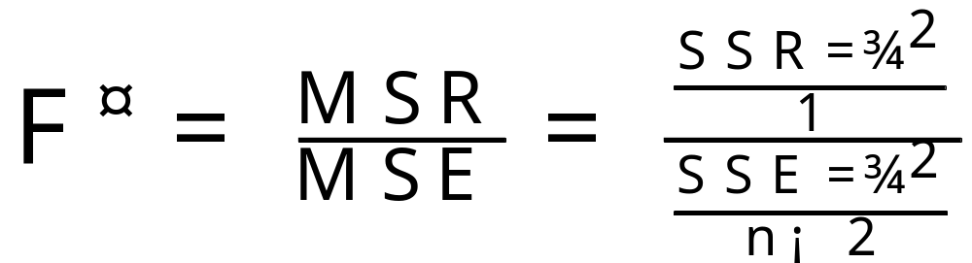
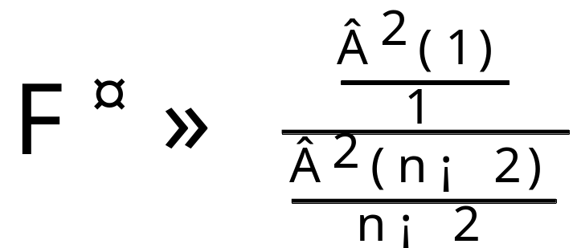
F* Test Statistic
F* can be written as follows
But by Cochran’s theorem, we have when H₀ holds

Slide 25
F Distribution
The F distribution is the ratio of two independent Â² random variables.
The test statistic F* follows the distribution
  F* ~ F(1,n-2)

Slide 26
Hypothesis Test Decision Rule
Since F* is distributed as F(1,n-2) when H₀ holds, the decision rule to follow when the risk of a Type I error is to be controlled at ® is:
  If F* · F(1-®; 1, n-2), conclude H₀
  If F* > F(1-®; 1, n-2) conclude H_{a}

Slide 27
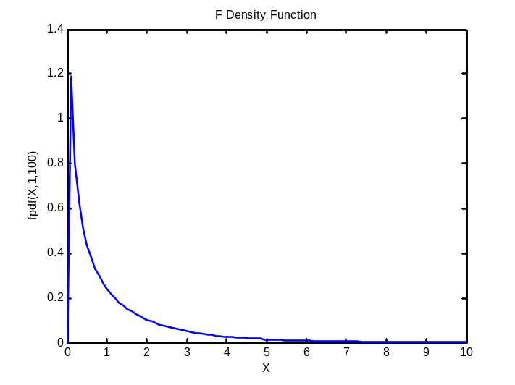
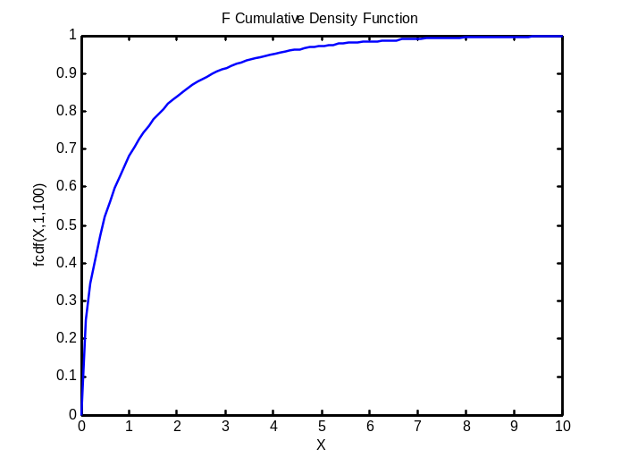
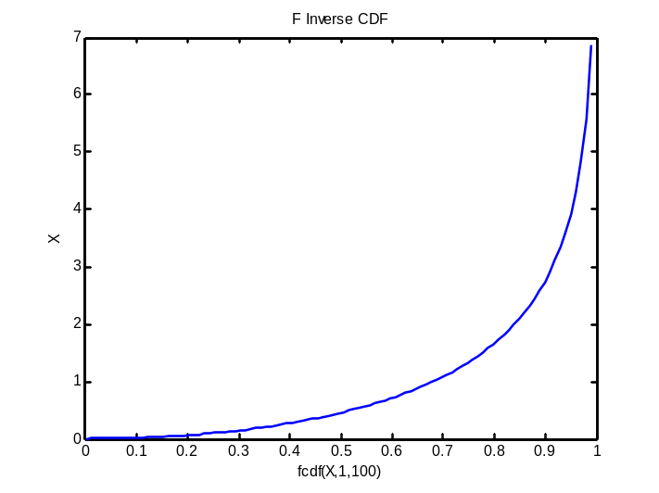
F distribution
PDF, CDF, Inverse CDF of F distribution
Note, MSR/MSE must be big in order to reject hypothesis.

Slide 28
Partitioning of Total Deviations
Does this make sense? When is MSR/MSE big?
SSTO
SSE
SSR

Slide 29
General Linear Test
The test of ¯₁ = 0 versus ¯₁ ≠ 0 is but a single example of a general test for a linear statistical models.
The general linear test has three parts
  Full Model
  Reduced Model
  Test Statistic

Slide 30
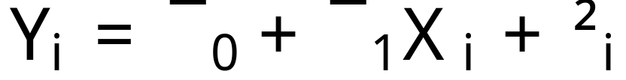
Full Model Fit
The standard full simple linear regression model is first fit to the data
Using this model the error sum of squares is obtained

Slide 31
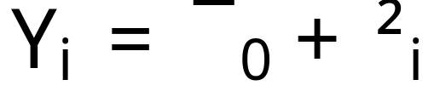
Fit Reduced Model
For instance, so far we have considered
  H₀ : ¯₁ = 0
  H_{a} : ¯₁ ≠ 0
The model when H₀ holds is called the reduced or restricted model. Here this results in ¯₁ = 0
The SSE for the reduced model is obtained

Slide 32
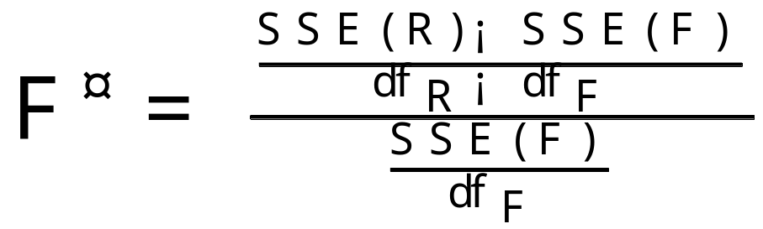
Test Statistic
The idea is to compare the two error sums of squares SSE(F) and SSE(R).
Because F has more parameters than R
  SSE(F) · SSE(R) always
The relevant test statistic is
which follows the F distribution when H₀ holds.
df_{R} and df_{F} are those associated with the reduced and full model error sumes of square respectively

Slide 33
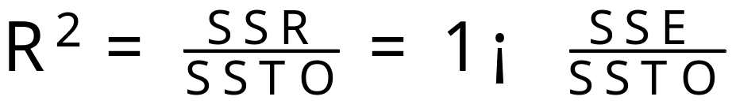
R²
SSTO measures the variation in the observations Y_{i} when X is not considered
SSE measures the variation in the Y_{i} after a predictor variable X is employed
A natural measure of the effect of X in reducing variation in Y is to express the reduction in variation (SSTO-SSE = SSR) as a proportion of the total variation

